Slide 1

DRAFT
Design System Project
A design system with a perspective on building accessible, usable, and beautiful apps.

Slide 2
OVERVIEW
DESIGN SYSTEM PROJECT
A use-case driven design system that helps organizations build accessible, usable, scalable, and beautiful apps.
A resource to learn best practices for user research, UI, usability, and voice and tone.

Slide 3
THE ORGANIZATIONAL PROBLEM
DESIGN SYSTEM PROJECT
Not-for-profit organizations operate on limited budgets and often need to prioritize things other than accessibility, research, and design.
When resources are available, they’re often constrained by a lack of expertise or organizational politics.

Slide 4
THE SOLUTION SPACE
DESIGN SYSTEM PROJECT
The tools available today are a collection of atomic components that designers and developers use in piecemeal fashion to create their apps.
These solutions tell you what the component is, but doesn’t think about the systems that those components belong in. An example is a data table. There are many choices for tables, search, filtering, sorting, pagination, etc, but none consider how they should be used and how the system scales.
No guidelines around voice and tone.
The solutions today do not focus on core use cases, leaving app creators in a position to need usability, accessibility, and visual design experts.
The result is inconsistent or unusable UX in fragmented ecosystems.

Slide 5
OPPORTUNITY FOR THE COMMUNITY
DESIGN SYSTEM PROJECT
By creating an open source design system driven by the core use cases of the internet freedom community, we can reduce the inconsistency in UX, provide accessible solutions, and provide a low-to-no-maintenance system that keeps projects always up-to-date with the changing design landscape.

Slide 6
MISSION STATEMENT
DESIGN SYSTEM PROJECT
To serve the internet freedom and open source community with thoughtful guidance for building inclusive, usable, scalable, and beautiful apps.
Create a security-minded design system that organizations can use to keep their apps up-to-date with the current research, best practices, and standards to ensure the best user experience for their global community.

Slide 7
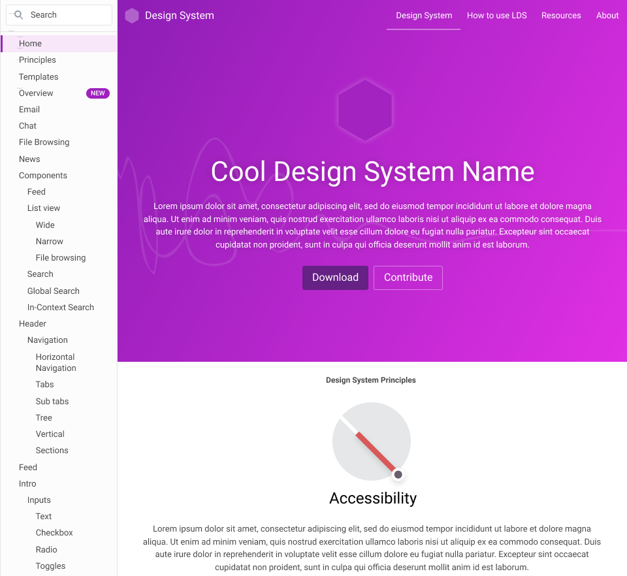
WHAT MIGHT IT BE?
DESIGN SYSTEM PROJECT

